Slide 1
The Image of the Hero and the “Macho” in the Mexican Ballads during the Mexican Revolution
Antonio Gómez-Zavala
Advisors: Dr. Donaldo Urioste & Dr. Rafael Gómez

Slide 2
Overview
The Mexican Ballad
The Mexican Revolution
“Machismo”/Manhood
The image of the Hero and the “Macho”
Mexican Ballads of Heroism and “Machismo” in 3 Stages
Conclusion

Slide 3
Research Questions
How machismo manifest itself in Mexican ballads (known as Corridos) in the late 19th century and early 20th century?
How do Mexican ballads narrate stories of heroism and “machismo”/manhood?
How much of this stories is true and how it is reflected in the culture?

Slide 4
The Mexican Ballad
Genre
Epic-lyric
Derived from the Spanish romance
Structure
Starts by describing the date & place where the event took place/happened
Verses of 16 syllables divided into hemistiches of 8 syllables
Assonance and consonant rhymes
Repetition of lyrical forms at the end
A-ño-de- mil- o-cho- cien-tos
no-ven-ta- y seis- del- co-rrien-te,
murió don Demetrio Jáuregui
que era un gallo muy valiente.
Con-
sonant
(Corrido de Demetrio Jáuregui, Custodio,1975: 144-146)
<<and with this I say good bye…>>
<<fly, fly little dove…>>

Slide 5
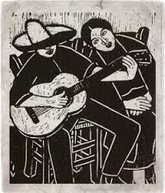
The Mexican Ballad
Content & Purpose
Varies depending on the existence and purpose of the author
Narrates the history of what was happening during a given time
Reflects the events of a historical period full of violence and injustices
Has a news value and a propagandistic or ideological content

Slide 6
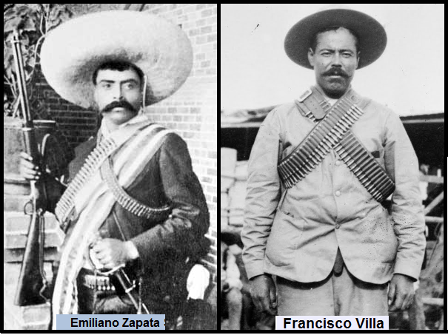
The Mexican Revolution
The “Porfiriato” (1875-1910)
The Mexican Revolution (1910-1920)
Plan of San Luis Potosi initiated by Francisco I. Madero
On November 20, 1910, the Mexican Revolution started
Fight for/demanding
Equality, justice, equity and liberty
No re-election
Land and Liberty

Slide 7
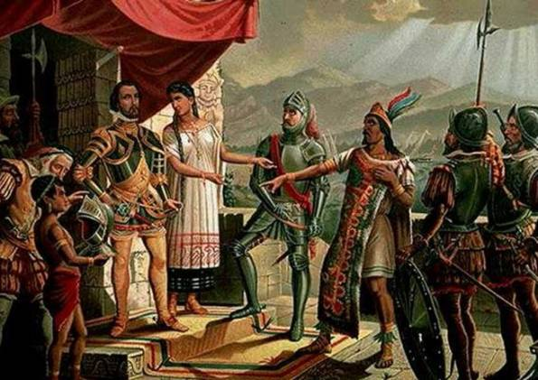
“Machismo”
Nahuatl Culture
Honorable man, trusted and respected by the community
Nowadays
Controls the family, beats and abuses women
Origin in Mexico, according to Vicente T. Mendoza
Inherited from Spain
In the conquest, when Hernán Cortés & his soldiers raped the women of the Aztecs
The mestizo was born, he hates and envies his Spanish father & despises his indigenous mother

Slide 8
Machismo: The Image of the Macho
Authentic Machismo/Masculinity
Real courage, generosity, heroism, bravery, religiosity to death, eagerness to fight, challenges the dangerous situations…and audacity proven
Is just the courage and the heroic ideal
False Machismo/Masculinity
Something only of appearance, that hides cowardice and fear, hidden with shoutings, that doesn’t correspond to reality because in front of the danger shrinks and before death frightens
Super masculinity that covers a complex of inferiority

Slide 9
Heroism: The Image of the Hero
The Hero
Defined by its religiosity, bravery/courage, loyalty, relation with the father and mother, generosity, amorous, machismo/masculinity, likes alcohol, revenge, cruelty, pride, etc.
Has to be a brave man that risks himself in any situation and is fearless
Courage is the most important characterization, without it, one can not be hero

Slide 10
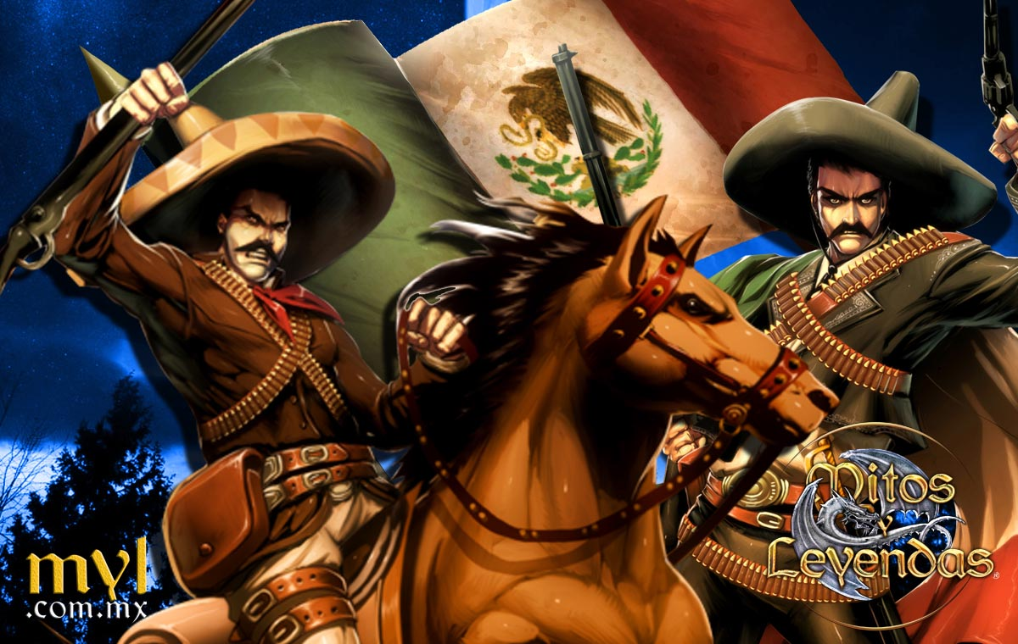
Heroism & Machismo in the Ballads
How Mexican ballads narrate stories of heroism and Machismo?
Present the brave protagonist as:
A man out of the ordinary
Fearless
Fights for a cause that he believes is correct, trying to do the right thing
Showing his love/interest in women and his ability to handle weapons

Slide 11
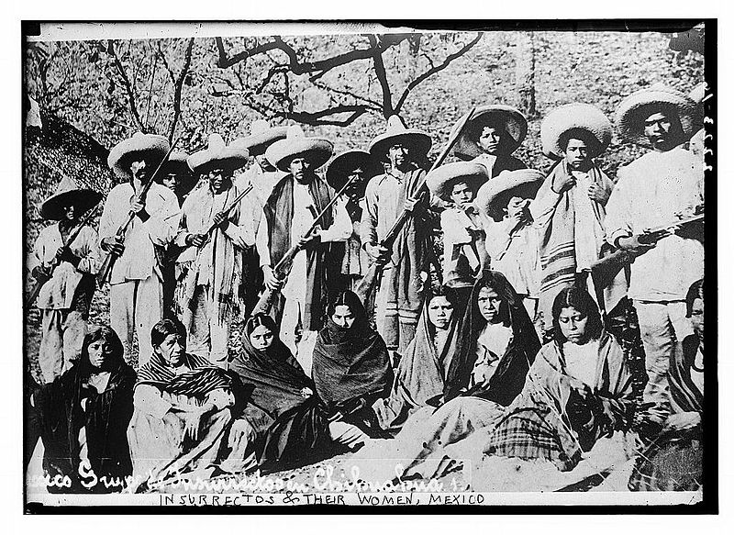
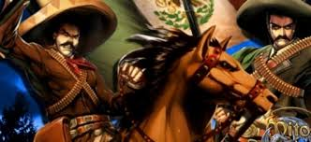
How much of this stories is true and how it is reflected in the culture?
Shows a reality/true but incomplete
Reality
Reflects a culture belonging to an epoch in which the protagonist lived
Incomplete
The exaggerated aspect of presenting the adventures of the protagonist/characters of the ballads

Slide 12
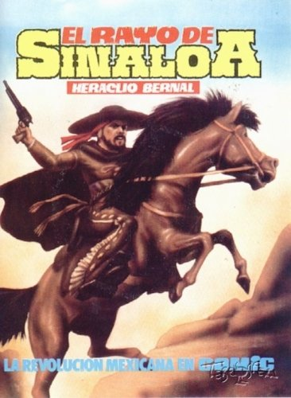
“Porfiriato” Stage (1875-1910)
Ballad of Heraclio Bernal (1882, 1885)
Localization
End of the 19th Century
Sinaloa State
Theme
Outlawry
Heroism
Que valiente era Bernal,
en su caballo retinto,
con su pistola en la mano,
peleando con treinta y cinco.
…
A ninguno le temía,
ni en la tierra ni en el mar,
era un hombre a toda prueba,
sin ponerle ni quitar.
(Corrido de Heraclio Bernal, Custodio, 1975: 136-139)

Slide 13
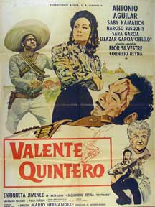
Revolutionary Stage (1910-1930)
Ballad of Benito Canales (1913)
Theme
Heroism, revolutionary hero
Ballad of Valente Quintero (1922)
Localization
1920s, Badiraguato Municipality, Sinaloa
Theme
“Machismo”
Valente andaba borracho
y andaba escandalizando:
–Con esta cuarenta y cinco
no respeto ningún grado.
…
Ya Valente anda borracho
en su caballo montado,
con la pistola en la mano
y a las muchachas besando.
…
Yo no soy ocasionado,
yo soy hombre de valor
nos daremos de balazos
si usted gusta, mi mayor.
Valente esta agonizando
dándole cuenta al creador,
alzo los brazos al cielo
y dio un balazo al mayor.
(Mendoza, 1995: 199-201)

Slide 14
Subsequent Stage (1930-)
The use of the word “macho” in the ballads
Association with various factors
The figure of the gunman who runs over/walks over the citizens
WWII
Presidency of Manuel Avila Camacho (1940-1946)
¡Viva el pueblo siempre macho!
Agustín el general
y ¡Viva Ávila Camacho
y la vida sindical!
As cited in Américo Paredes, 1967: 69

Slide 15
Conclusion
Mexican ballads are still valued/appreciated in the culture
In the present, we can hear song about the adventures of brave men that fought during the “Porfiriato” and Mexican Revolution
Even thought, as time goes by, some ballads are/have been modified to satisfy or gratify new generations

Slide 16
Questions/Comments

Slide 17
Bibliography
Custodio, Álvaro. El Corrido Popular Mexicano: Su Historia, Sus Temas, Sus Interpretes. 1. ed. Madrid: Ediciones Jucar, 1975. Print.
Eguiarte Bendímez, Enrique A. "El Corrido Mexicano: Elementos Literarios Y Culturales." RILCE: Revista De Filología Hispánica, 16.1 (2000): 77-92.
Garza-Ramos, María del Carmen. “Fisonomía del Héroe en el Corrido Mexicano.” Dialogos: Artes, Letras, Ciencias Humanas, 4.6 (1968): 12-16.
González, Aurelio. "Caracterización De Los Héroes En Los Corridos Mexicanos." Cahiers Du Monde Hispanique Et Luso-Brésilien/Caravelle, 72 (1999): 83-97.
González, Aurelio. "¿Como Vive el Corrido Mexicano? ¿Quien Canta Corridos? ¿Quienes Cantaron Corridos?." Cahiers Du Monde Hispanique Et Luso-Brésilien/Caravelle, 51 (1998): 23-30.
González, Aurelio. “Literatura Tradicional y Literatura Popular. Romance y Corrido en México.” Caravelle, 65 (1995): 143-157.
González, Aurelio. “Descriptividad en el Corrido Tradicional.” Caravelle, 76/77 (December 2001): 495-505.
González, Aurelio. "El Corrido: Expresión Popular Y Tradicional De La Balada Hispánica." Olivar: Revista De Literatura Y Cultura Españolas, 12.15 (2011): 11-36.
Mendoza, Vicente T.. El Corrido Mexicano. 3a. ed. México: Fondo de Cultura Económica, 1976. Print.
Paredes, Américo. "Estados Unidos, México Y El Machismo." Journal of Inter-American Studies, 9.1 (1967): 65-84.
Parra, Max. “Pancho Villa y el Corrido de la Revolución.” Caravelle, 88 (2007): 139-149.
Ramírez-Barradas, Herlinda F. “La Transformación de un Héroe de Corrido a través del Tiempo.” Hispania, 83 (Mayo, 2000): 189-197.
Román, Carmen. “Machismo y Marianismo: Nuevos Modelos para Viejos Patrones.” Time2Track, LLC, (2012). Retrieved 23 April 2014 from: http://time2track.com/machismo-marianismo
Rodríguez, Roberto & Gonzales, Patrisia. “Deconstructing Machismo.” Retrieved 23 April 2014 from Latino Spectrum: http://www.mexica.net/literat/macho.php (National Hispanic Univ.edu/ Chrinicle features, San Francisco released date (june 20,1997)

